Slide 1
Literature.Reviews.Oct8.2018
Reconstruction

Slide 2
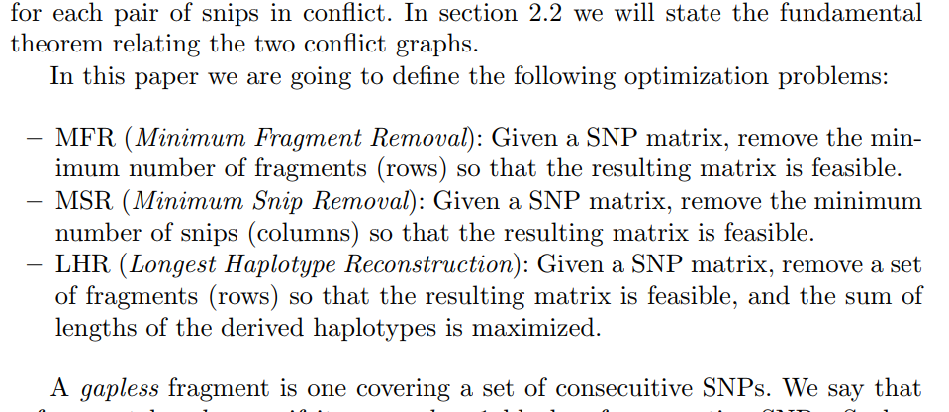
Lancia, 2001
Objective Functions for each case: Dealing with gaps & gapless

Slide 3
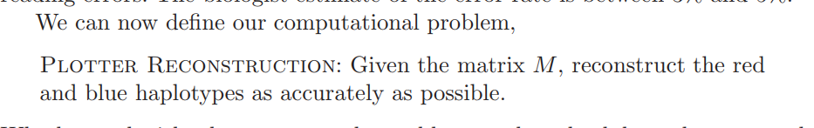
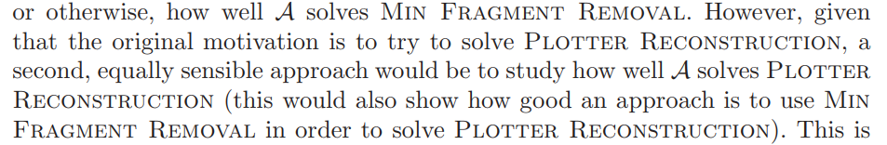
Fast Hare, 2004
Problem:

Slide 4
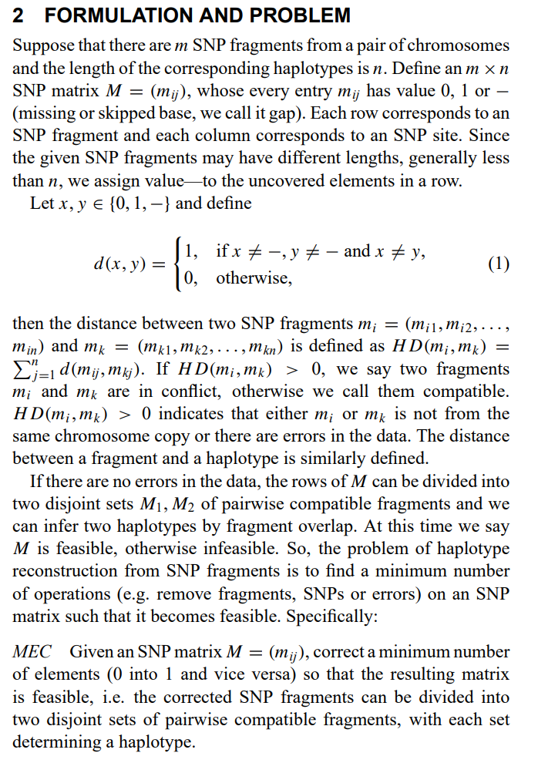
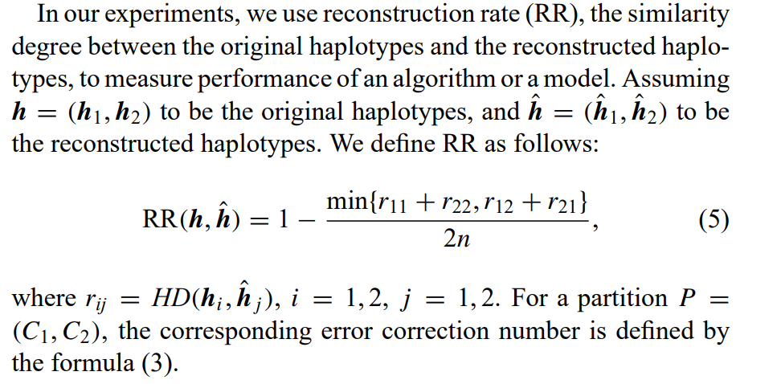
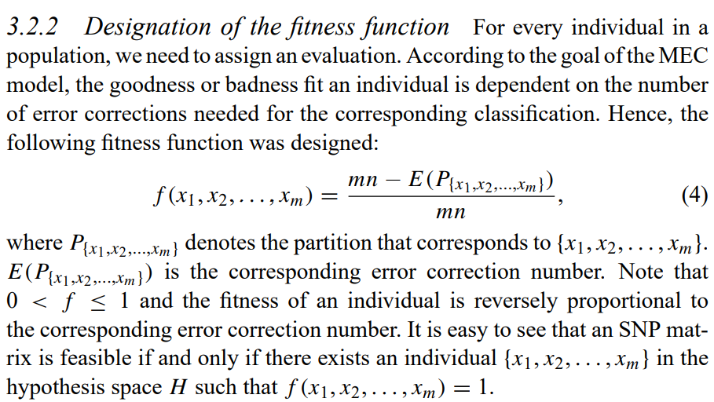
Wang, 2005
Reconstruction:
Fitness Function:
Page, 2458
Page, 2458
Pedigree, (page2459):
The haplotypes of 129 children from the trios can be inferred from the genotypes of their parents through pedigree information and the nontransmitted chromosomes as an extra 129 (pseudo) haplotype pairs.

Slide 5
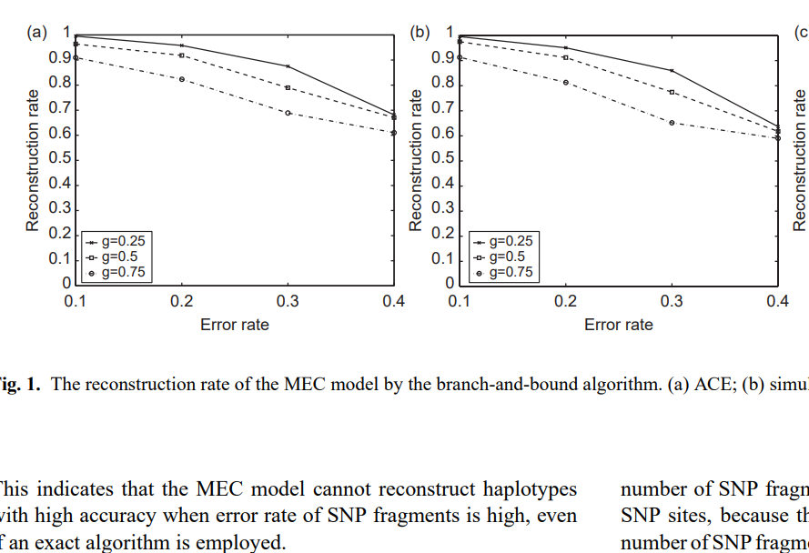
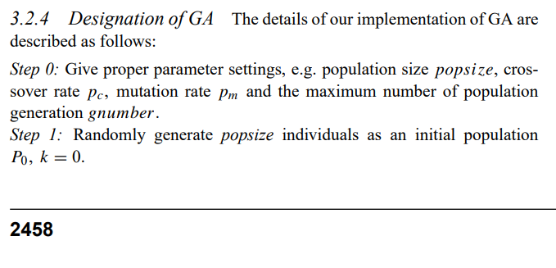
Wang, 2005
Evaluates accuracy via error rate of SNP fragments, page 4.
Uses Mutation Rate in Genetic Algorithm (GA), page 3.

Slide 6
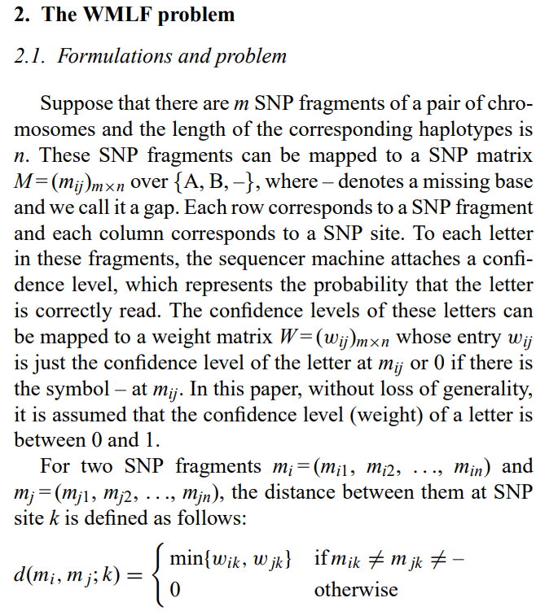
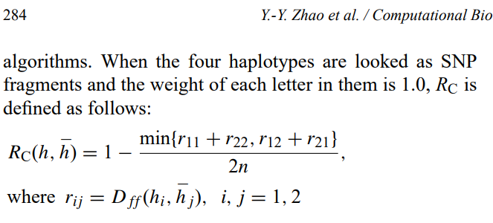
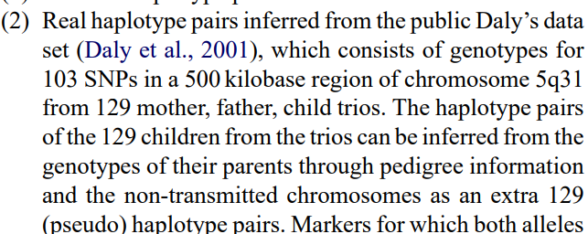
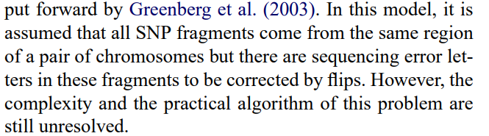
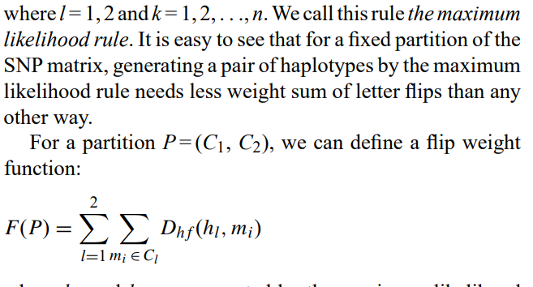
Zhao, 2005
Reconstruction Rate: Pedigree:
Objective Function
Sequencing error

Slide 7
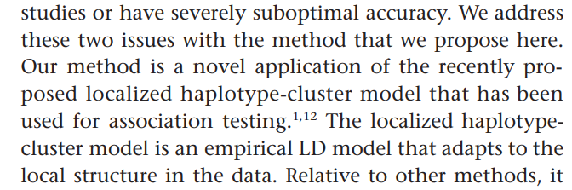
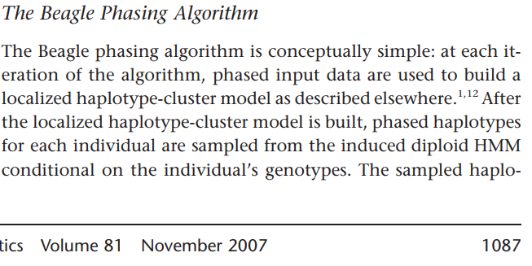
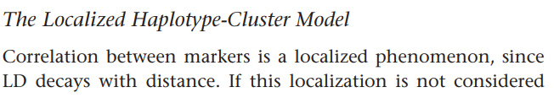
Beagle, 2007
Linkage Disequilibrium: Function Model:
No Formulations & problems Section

Slide 8
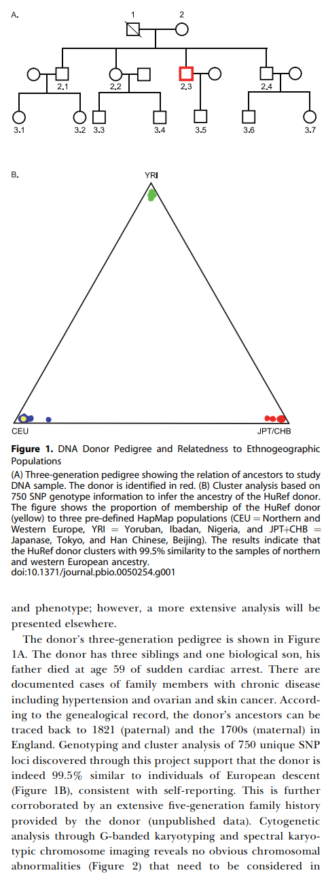
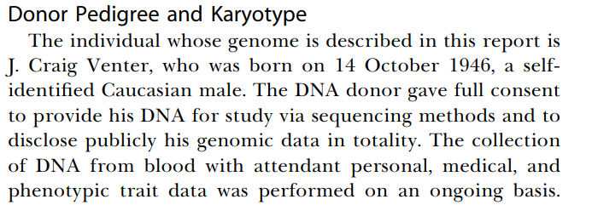
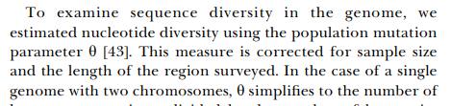
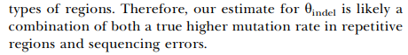
DGS (HuRef), 2007
Pedigree: * Genome Dataset
Similar to NCBI & WGSA
Mutation rate:
Sequencing error

Slide 9
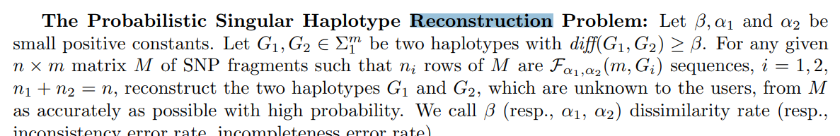
HapRec,2008
Reconstruction:
Probabilistic Approach.
No formulations & problems section

Slide 10
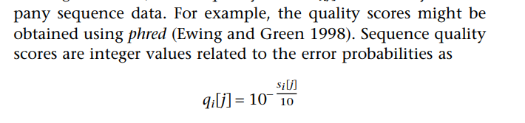
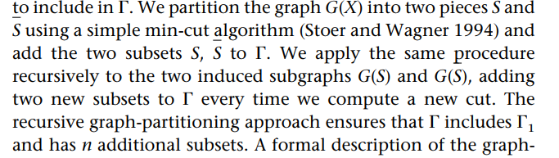
HASH, 2008
Sequencing error: *No formalization /problem section
Objective Function/approach:

Slide 11
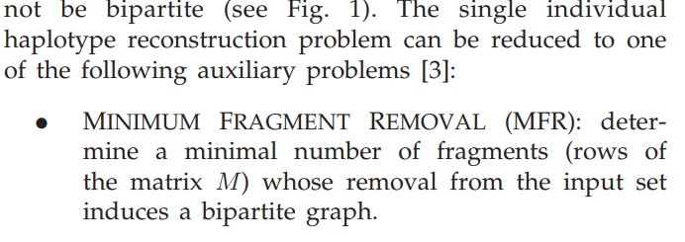
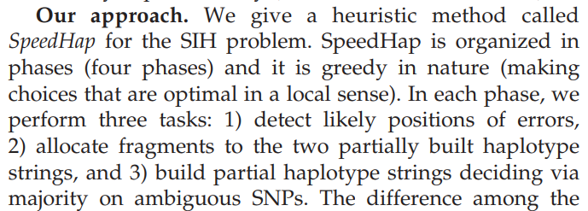
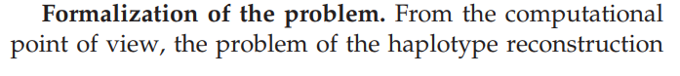
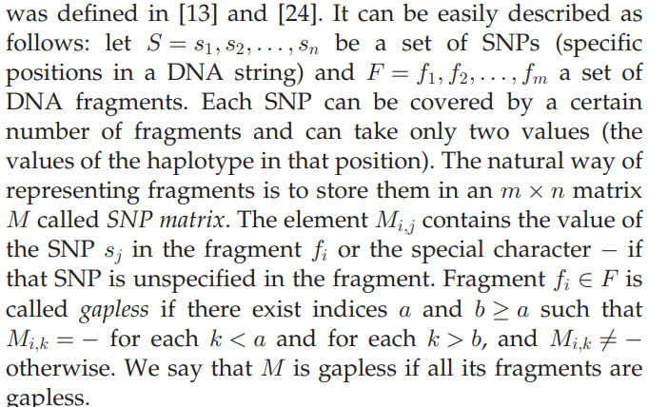
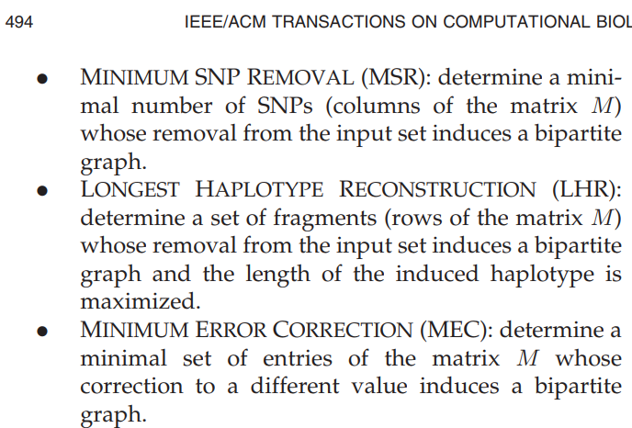
SpeedHap, 2008
Sequencing error:
Reconstruction:

Slide 12
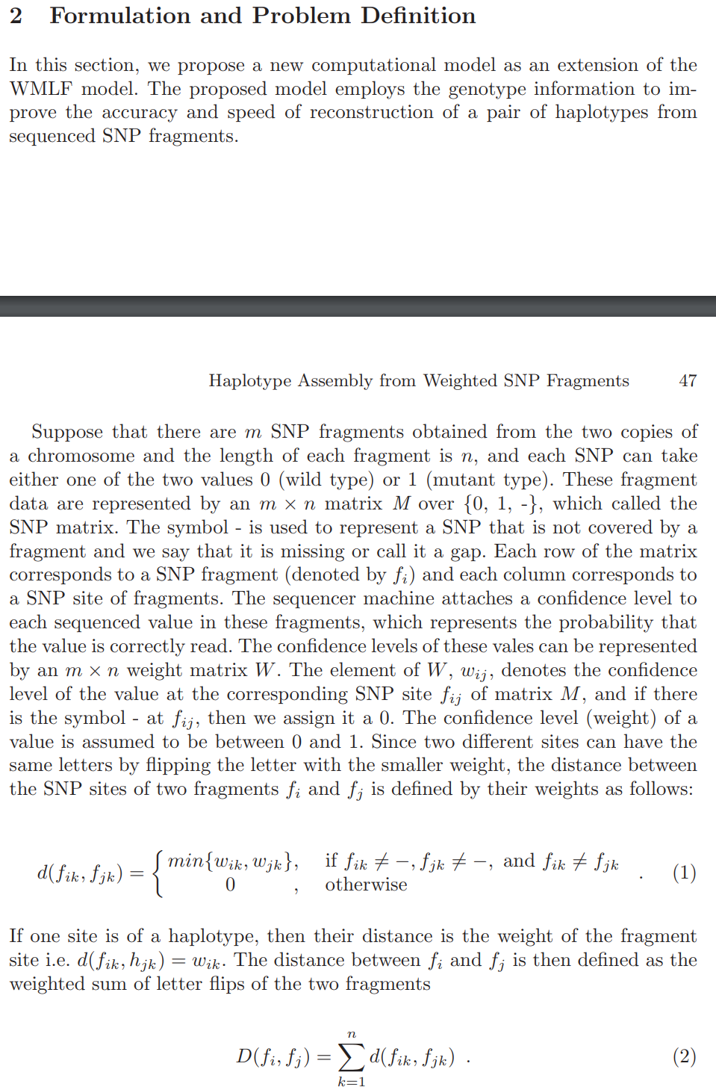
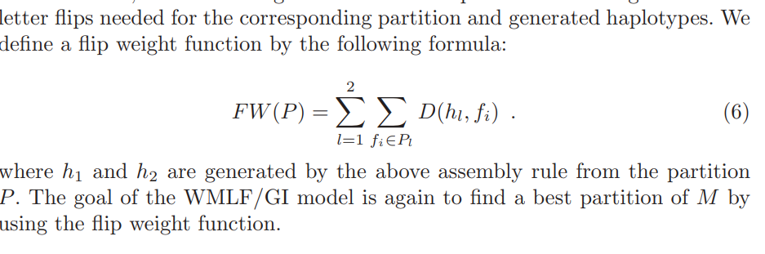
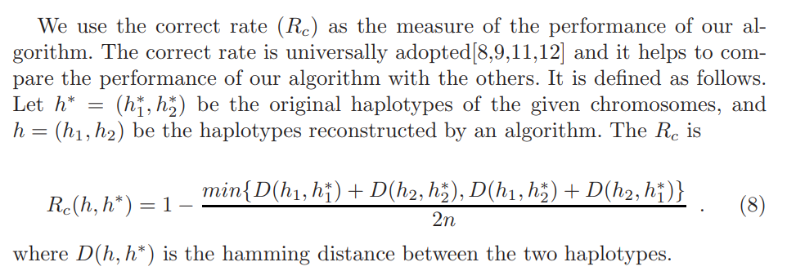
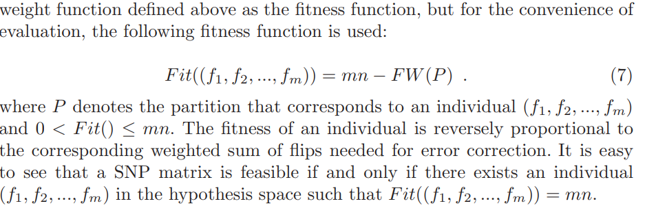
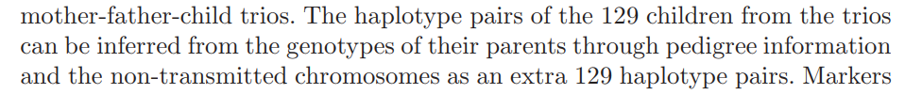
Kang, 2008
Objective Function:
Pedigree
Reconstruction:

Slide 13
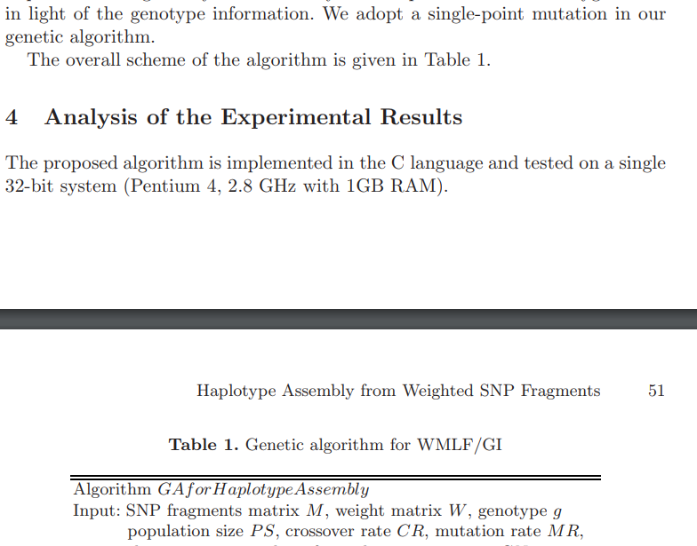
Kang, 2008
Mutation Rate, page 6

Slide 14
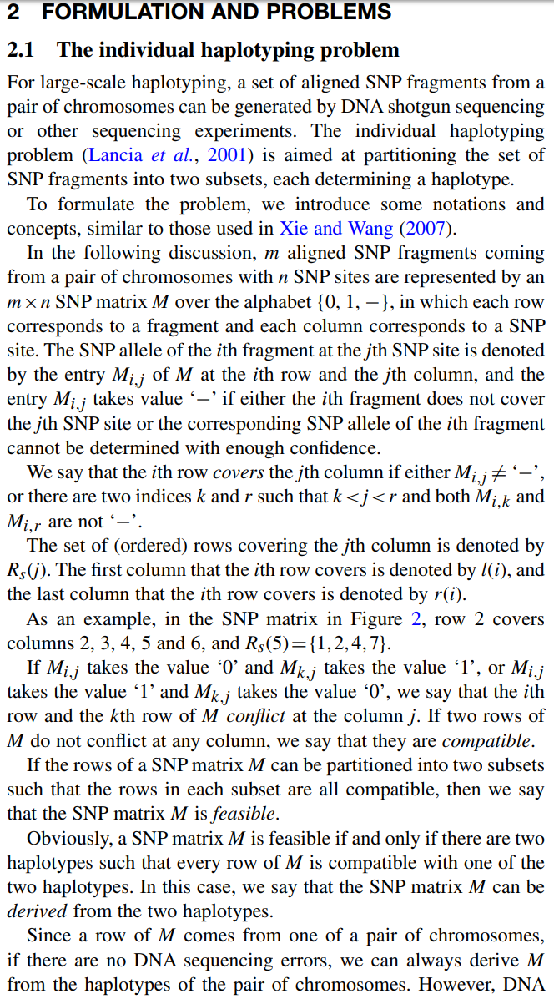
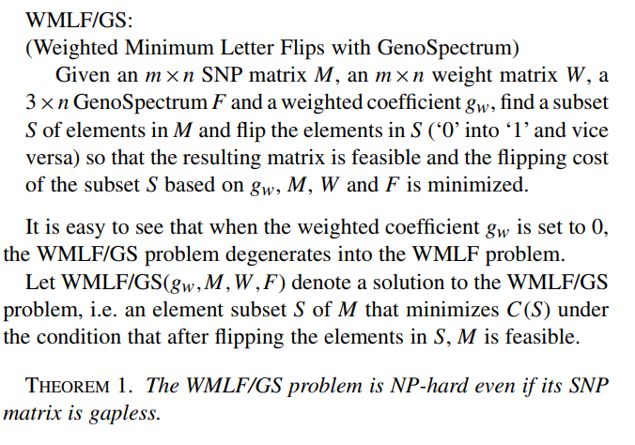
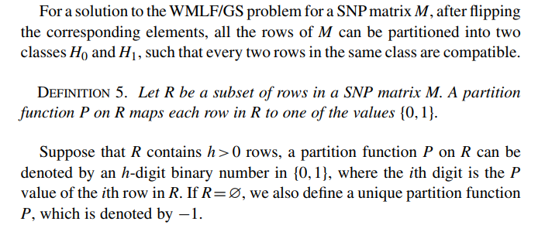
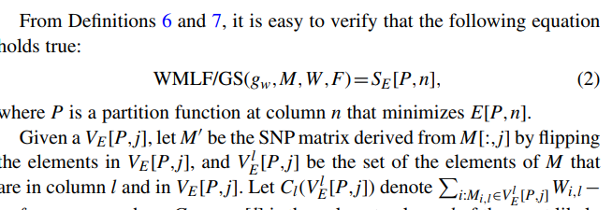
Xie, 2008
Algorithm:
Partition Function:

Slide 15
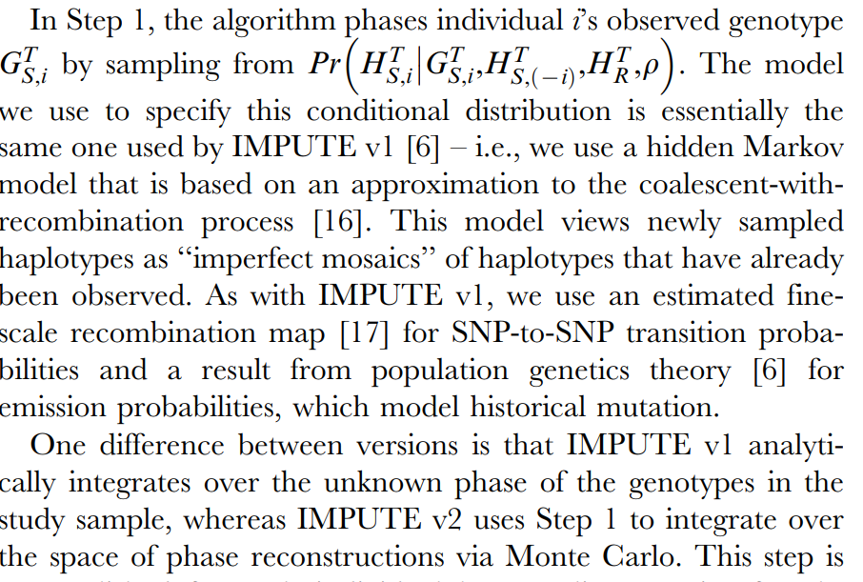
IMPUTE2, 2009
No formulations & problems section
recombination
reconstruction

Slide 16
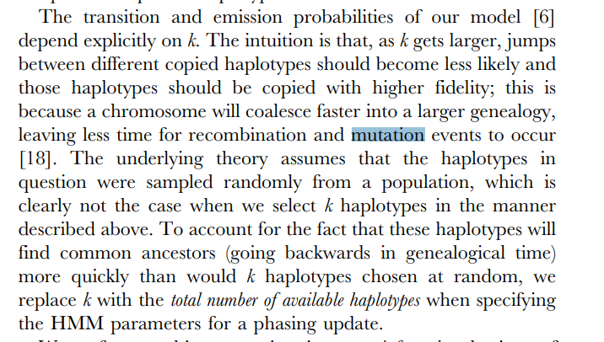
IMPUTE2, 2009
Mutation & Recombination, page 5

Slide 17
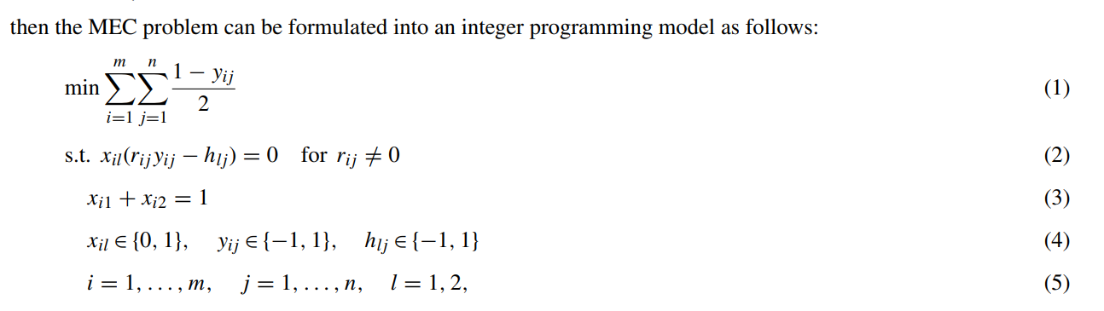
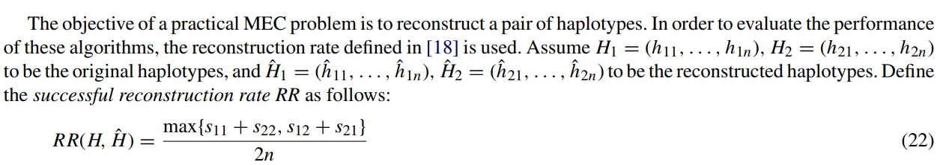
Wu, 2009
Pedigree:
The haplotypes of 129 children from the trios can be inferred from the genotypes of their parents through pedigree information and the nontransmitted chromosomes as an extra 129 (pseudo) haplotype pairs. Markers for which both alleles could not be inferred were marked as missing.
No formulations & problems section
Objective function
Reconstruction:

Slide 18
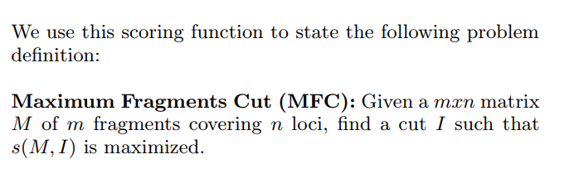
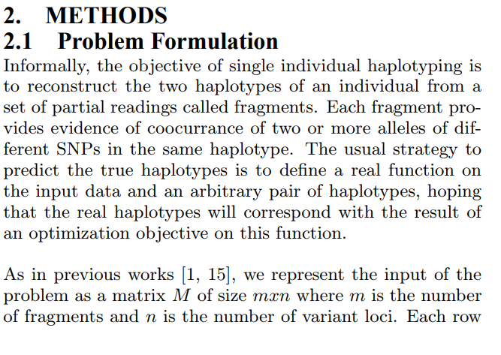
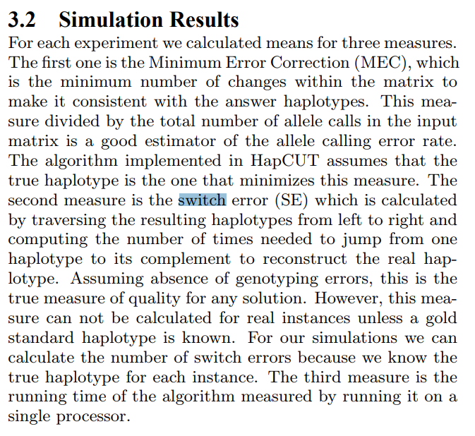
RefHap, 2010
Objective Function:
MEC & switch error & running time:

Slide 19
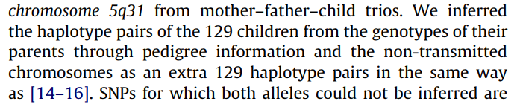
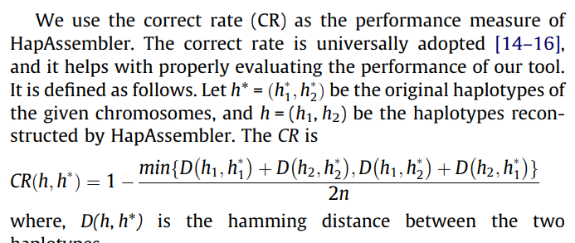
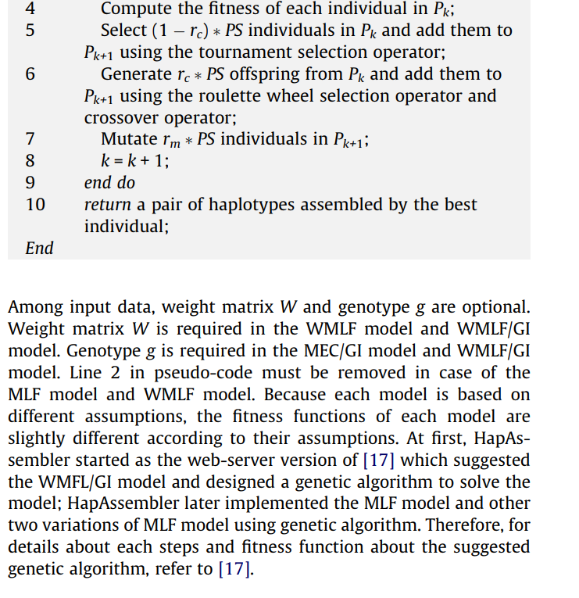
HapAssembler, 2010
Pedigree:
Mutation Rate
Reconstruction:
Fitness function:
No Formulations & problems section

Slide 20
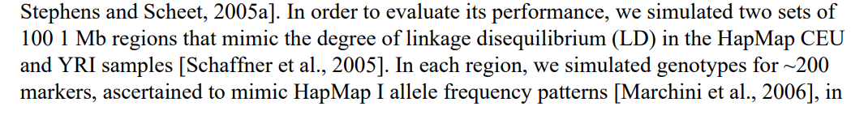
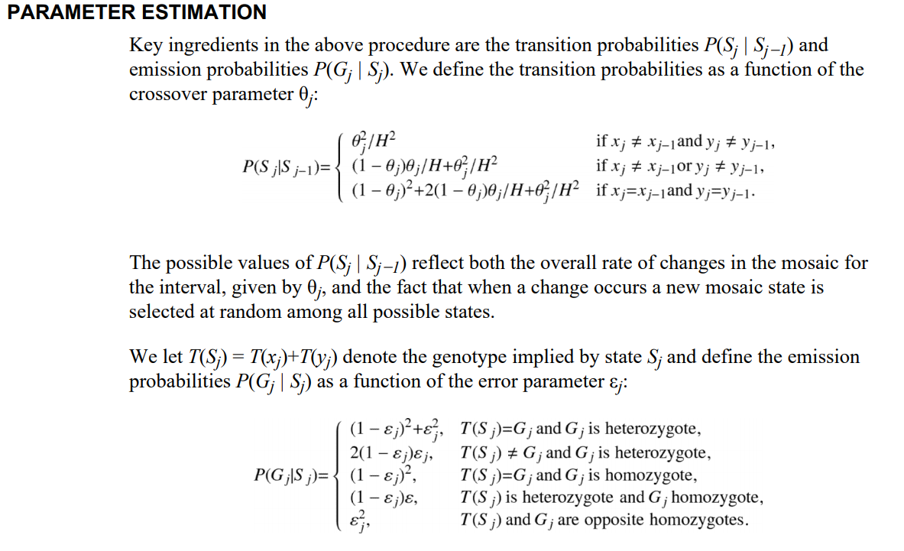




MaCH, 2010
LD:
No Formulations & problems section
$←$Genotyping error mutation

Slide 21



MaCH, 2010
Reconstruction rate:

Slide 22

MaCH, 2010
Objection Function:
Page 16

Slide 23

MaxSAT, 2010
Objective Function
No Formulations & problems section

Slide 24



Xu, 2010
Reconstruction: Objective Function:
No Formulations & problems section

Slide 25
Meeting Oct9.2018
Finish highlighting key features
Incorporate formulation of problem section for each paper!
Review Pedigree section:
Is trio data used as a reference similar to HapMap haplotype references or is the SNPs from trio data being “reconstructed” into haplotypes?
Keep Poster in mind:
Want to add 3-4 more slides regarding key

Slide 26

HALLDORSSON, 2011

Slide 27



HapSAT, 2011
Objective Function:
Page, 2

Slide 28


HapCompass, 2012

Slide 29



HMEC, 2012
MEC problem:
Objective Function

Slide 30


HATS, 2012
LD
Objective function:

Slide 31




PPHS, 2012
Problem: Reconstruction: Objective Function:

Slide 32



GAHap, 2012
Problem: Objective function: Mutation:

Slide 33




H-BOP, 2012
Problem: Objective function: Sequencing error:
Time:

Slide 34


2012, HapSeq
Objective Function:
Recombination:
: Sequencing error

Slide 35
HAPI-UR, 2012

Slide 36

SHAPEIT, 2012
Mutation, recombination, fitness function:

Slide 37
SHAPEIT, 2013

Slide 38


Chen, 2013
Problem: Objective Function:

Slide 39

Deng, 2013
Objection Function:

Slide 40


Hap-SeqX, 2013
Objective Function:
Sequencing Error:

Slide 41


MixSIH, 2013
Reconstruction: Objective function:

Slide 42


Harsh, 2013
Haplotype phasing with both sequencing data and reference
Objective function
Description of algorithm

Slide 43



DBM, 2013
Sequencing error & quality score: Recombination:

Slide 44





HapSeq2, 2013
Recombination:
Sequencing error: LD:

Slide 45


HapCompass-Tumor
Sequencing error: Objective Function:

Slide 46



HapTree, 2014
Objective function: Reconstruction:
Sequencing errors:

Slide 47


HGHap, 2014

Slide 48

ProbHap, 2014
Objective function:

Slide 49

CSP, 2014
Objective function:

Slide 50



FastHap, 2014
Problem: Switch error: Reconstruction:

Slide 51


WinHap2, 2014
Objective: Speed:
Unique:
Divide and conquer strategy
Parallelization

Slide 52



ParticleHap, 2015
Problem: Objective function:
Linkage Disequilibrium:

Slide 53


HapCut2, 2017
Objective Function:
Unique:
Uses fosmid –based dilution pool, 10X Genomics linked-real data, PacBio SMRT data, & Hi-C data

Slide 54





PEATH, 2018
Estimation of distribution Algorithm: Objective function:
Quality Score:
Switch error:

Slide 55



AROHap, 2018
Objective function:

Slide 56

2018, HapCHAT
Objective function & Runtime

Slide 57


WhatsHap, 2014
Problem Objective function

Slide 58



HapCol, 2016
Time/Speed: Problem section:
Objective Function

Slide 59
Experimental Methods
E1-E9

Slide 60




MA, 2010 E1
Sequencing Technology: Samples
Tools used to get haplotype assembly
Hap. Reconstruction Method

Slide 61



Duitama, 2011 E2
Sequencing Technology:
Sample:
Tools used for Haplotype Assembly
See page 3, Methods & materials
Haplotype reconstruction method:

Slide 62



Fan, 2011 E3
Sequencing Technology:
Samples: Read Length:
Haplotype reconstruction method:

Slide 63



Peters, 2012 E4
Sequencing Technology: Samples:
Read Length:

Slide 64


Peters, 2012 E4
Tools to assembly haplotype
Haplotype reconstruction Method

Slide 65






Kaper, 2013 E5
Sequencing Technology: Samples:
Tools used in haplotype assembly:
Read Length:
Hap. Reconstruction Method:

Slide 66



Kuleshov, 2014 E6
Sequencing Technology: Samples:
Tools used:
Read Length:
Haplotype Reconstruction Method

Slide 67


Zheng, 2016 E7
Sequencing Technology: Sample:
Read Length:
Tools Used:
Haplotype Reconstruction Method: Supplementary Note 1

Slide 68




Chu, 2017 E8
Sequencing Technology: Samples:
A Read Length:
Haplotype reconstruction Method:
Tools used:

Slide 69

Luo, 2018 E9
Sequencing Technology:
Samples:
Haplotype reconstruction Method:
Tools used:

